Slide 1
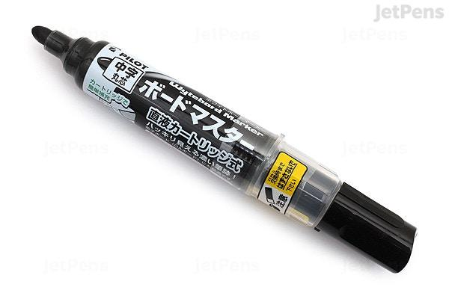
Testing for Marker

Slide 2
Requirement fo Marker Testing
Which type of Marker is it ? - White board / paper etc.
Who is the customer? Teacher/ Artist / student etc.
What is Marker type? Permanent / Non-Permanent etc.
Is it waterproofed? Yes/No
Marker color ? Red / Blue / Green etc.
Size and width? Thick / Thinner etc.
Branding & logo? What is logo / Branding etc.

Slide 3
Possible Testing tips
Write on a paper - should be able to write.
Write on different other material like - wood, metals etc.
Write with different angles on the board like 90 D, 30 D, 60D etc.
Write with on wet or on oily paper.
Color and visibility of written word by marker.
Marker is permanent marker or not.
Marker Branding and logo is as per requirement.
Marker has rubber grip.... etc.
UAT - Give marker to a teacher and ask for feedback.
Shake the marker and verify whether ink is flowing.
Drop the marker on the floor and pick up then verify it can be reused.
Refile the existing marker and try It can be reused.etc.

Slide 4
Keep writing on a whiteboard until ink finished to see how much time it can be used.
Put pressure on the marker while writing on the white board to see how much pressure it can be sustain.
Result is same after multiple uses.
Throwing on a hard/rough surface.
Verify it shouldn't break with less velocity.

